Slide 1
בשביל מה האתר תדמית? | סדרה
מה שם הסדרה? | וואן פיס
למי אני מפרסם? | מעריצים
מה אני צריך בשביל האתר? | תמונות, טקסטים על השחקנים, תקציר עלילה, דמויות, קישורים לפרקים וקישורים לחנויות.

Slide 2
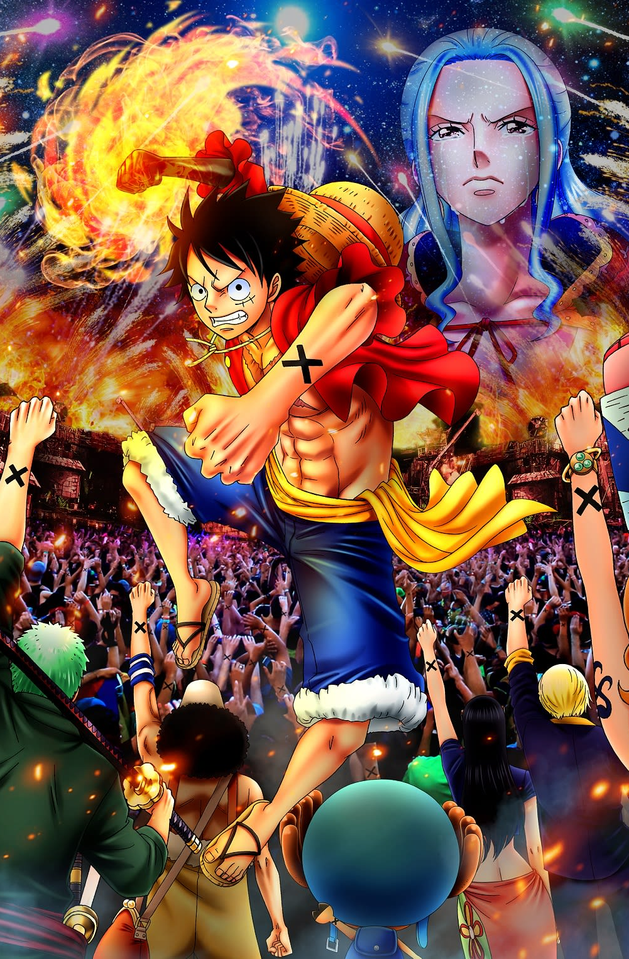



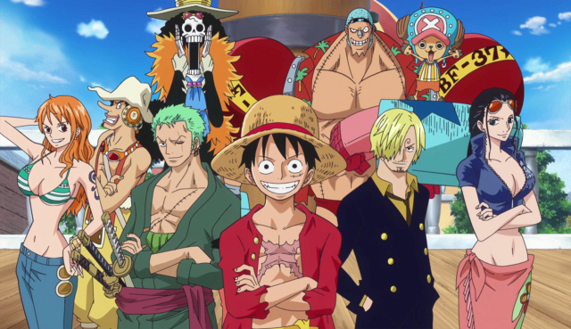

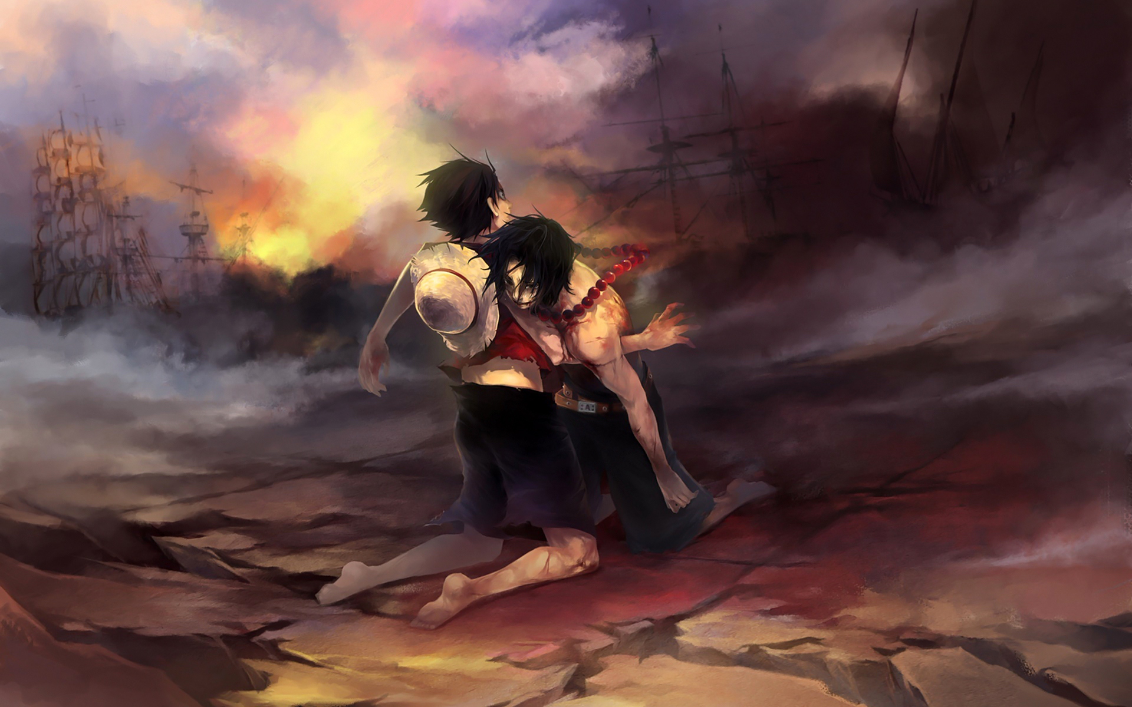
One piece Site
תקציר
One Piece (Japanese: ワンピース, Hepburn: Wan Pīsu) is a Japanese shōnen manga series written and illustrated by Eiichiro Oda. It has been serialized in Shueisha's Weekly Shōnen Jump magazine since July 22, 1997, and has been collected into 96 tankōbon volumes as of April 2020. The story follows the adventures of Monkey D. Luffy, a boy whose body gained the properties of rubber after unintentionally eating a Devil Fruit. With his crew of pirates, named the Straw Hat Pirates, Luffy explores the Grand Line in search of the world's ultimate treasure known as "One Piece" in order to become the next King of the Pirates.
דמויות
One Piece (Japanese: ワンピース, Hepburn: Wan Pīsu) is a Japanese shōnen manga series written and illustrated by Eiichiro Oda. It has been serialized in Shueisha's Weekly Shōnen Jump magazine since July 22, 1997, and has been collected into 96 tankōbon volumes as of April 2020. The story follows the adventures of Monkey D. Luffy, a boy whose body gained the properties of rubber after unintentionally eating a Devil Fruit. With his crew of pirates, named the Straw Hat Pirates, Luffy explores the Grand Line in search of the world's ultimate treasure known as "One Piece" in order to become the next King of the Pirates.
לינקים
One Piece (Japanese: ワンピース, Hepburn: Wan Pīsu) is a Japanese shōnen manga series written and illustrated by Eiichiro Oda. It has been serialized in Shueisha's Weekly Shōnen Jump magazine since July 22, 1997, and has been collected into 96 tankōbon volumes as of April 2020. The story follows the adventures of Monkey D. Luffy, a boy whose body gained the properties of rubber after unintentionally eating a Devil Fruit. With his crew of pirates, named the Straw Hat Pirates, Luffy explores the Grand Line in search of the world's ultimate treasure known as "One Piece" in order to become the next King of the Pirates.

